Slide 1


ARPA Coronavirus State Fiscal Recovery Funds
Nov. 15, 2021
Emily Maher
Senior Policy Specialist, Fiscal Affairs Program

Slide 2
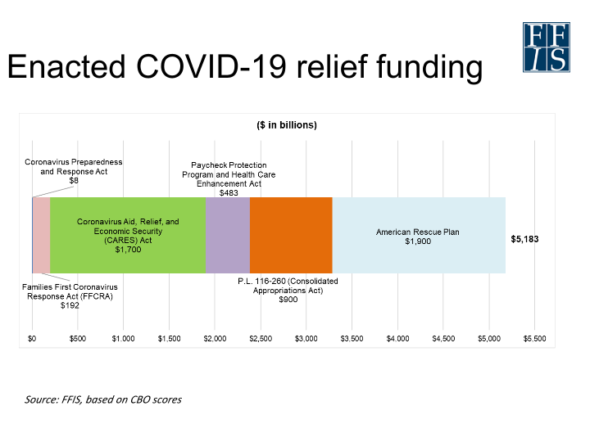

Slide 3
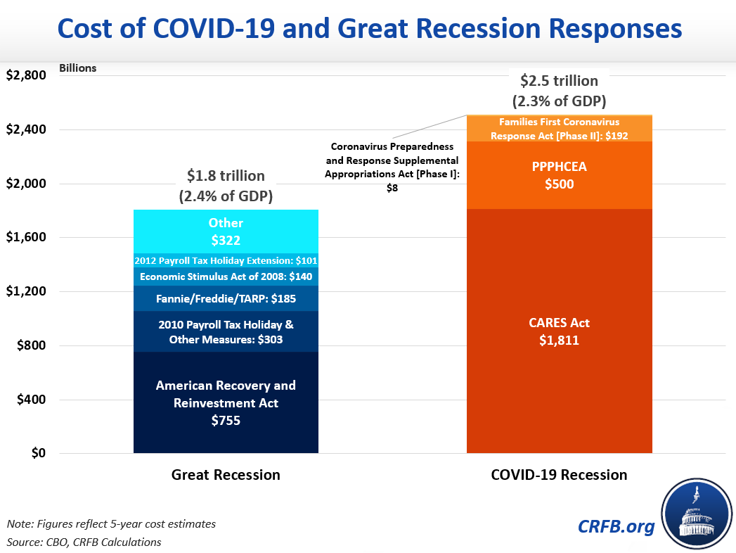

Slide 4
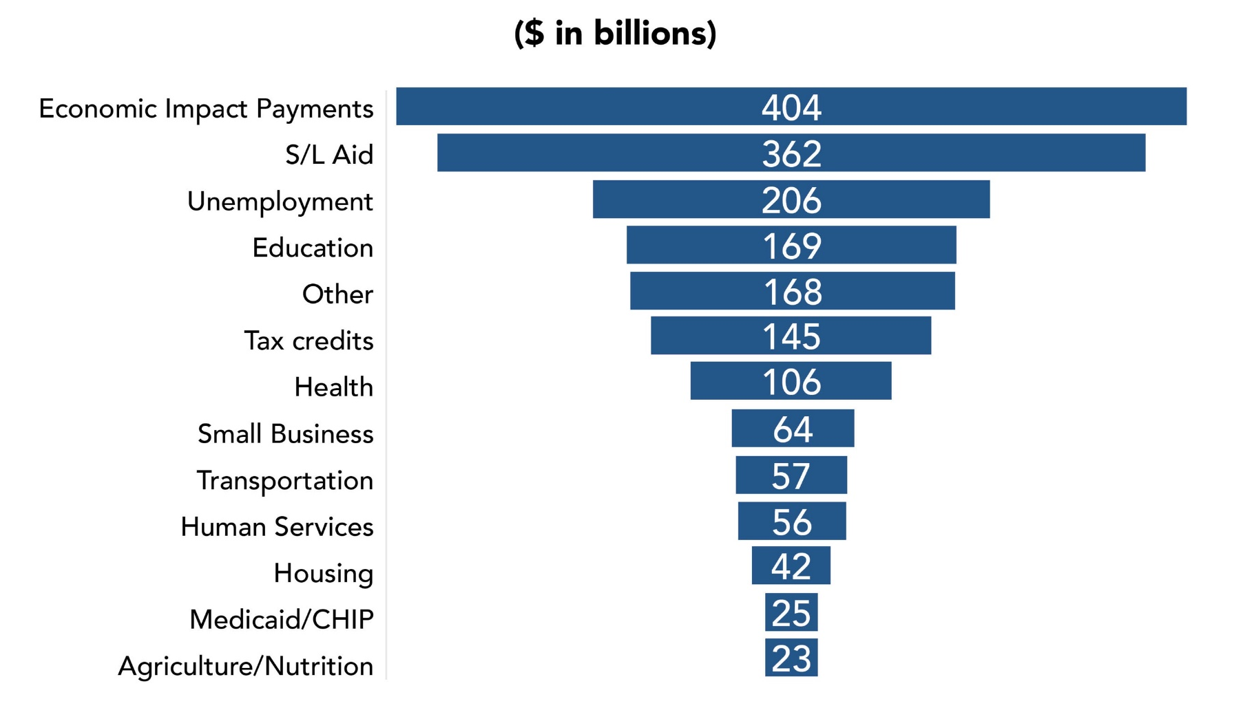
American Rescue Plan Act Funding

Slide 5


Flexible Spending for States
Coronavirus State and Local Fiscal Recovery Funds (CSLFRF)
Coronavirus Relief Funds (CRF)
$350 billion to state and locals
  195.3 billion to states and the District of Columbia
  $130.2 billion to local governments
Formula disbursement – minimum allocation and unemployment rate
Tranche disbursement
Funds must be obligate by Dec. 31, 2024 and spent by Dec. 31, 2026.
$150 billion to state, local, and tribal governments
  Each state received a min. allocation of $1.25 billion
  Funds must be spent by Dec. 31, 2021*

Slide 6
Guidance
CRF
CSLFRF
Allowable uses:
  Directly related to COVID-19
  Not accounted for in the budget approved before March 27, 2020
  Funds must be spent by Dec. 31, 2021*
Barriers
  Guidance released in piecemeal
  Cannot be used for revenue shortfalls
  Spending authority and allocation
  Uncertainty in federal packages
  Tight clock
Allowable uses:
  Emergency and Economic effects of pandemic
  Premium pay to essential employees or grants to their employers
  Government services affected by revenue reduction resulting from COVID-19
  Investments in water, sewer and broadband
Ineligible uses:
  Towards pensions or to offset revenue resulting in a tax cuts
  Rainy Day Funds
Interim Final Rule, but no Final Rule

Slide 7
CSFRF State & Local Aid
Provides $195.3 billion to states and the District of Columbia:
  $25.5 billion to each state, minimum of $500 million.
  $169 billion would be allocated based on the states’ share of unemployed workers over a three-month period, from October-December 2020.
Provides $130.2 billion to Local Governments:
  $65.1 billion for counties.
  $45.6 billion for metropolitan cities.
  $19.5 billion for towns with fewer than 50,000 people.
Provides $4.5 billion to U.S. territories.
Provides $20 billion to tribal governments.
Provides $10 billion for a Coronavirus Capital Projects Fund

Slide 8

More on Tranches
31 states subject to split
19 states and the District of Columbia received full disbursement.
Combined - $154.4 billion out the door initially.
$40.9 billion coming in 2022.

Slide 9
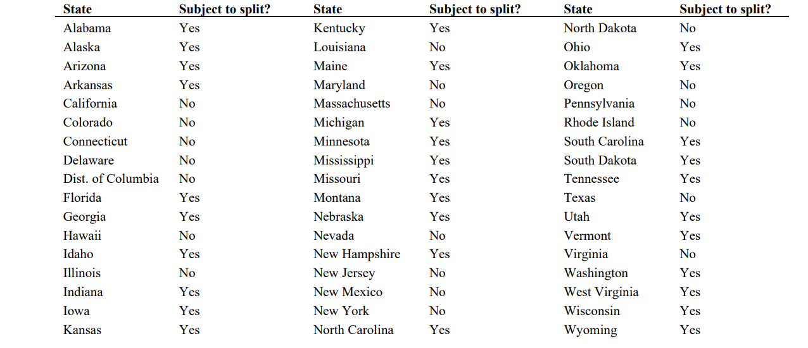

Slide 10
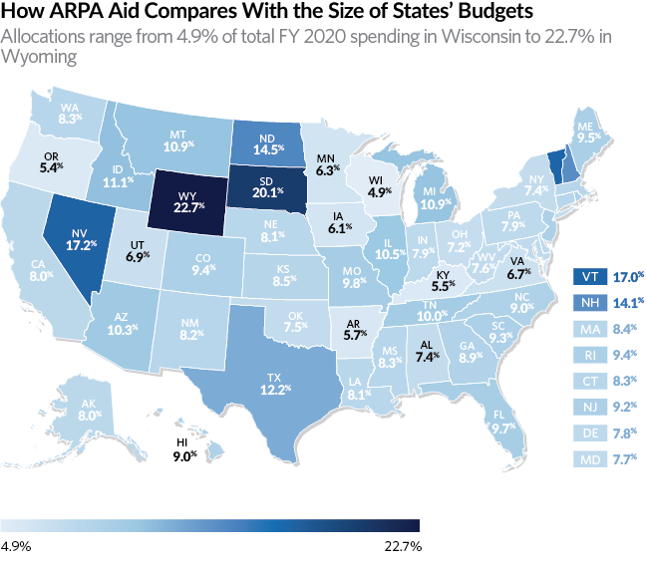
Source: The Pew Charitable Trusts, 2021, using U.S. Department of Treasury and National Association of State Budget Officer’s data.

Slide 11
State CSFRF Allocations
AK
WA
ID
MT
ME
OR
ND
MN
MI
WI
NY
RI
WY
SD
CA
CT
NV
PA
UT
NE
IA
OH
VT
NH
IL
IN
CO
WV
NJ
MA
UT
KS
MO
VA
KY
DE
MD
AZ
NM
NC
DC
OK
TN
TX
AR
SC
MS
AL
GA
Legislative
Executive
HI
LA
FL
Legislative and Executive
Has not allocated

Slide 12
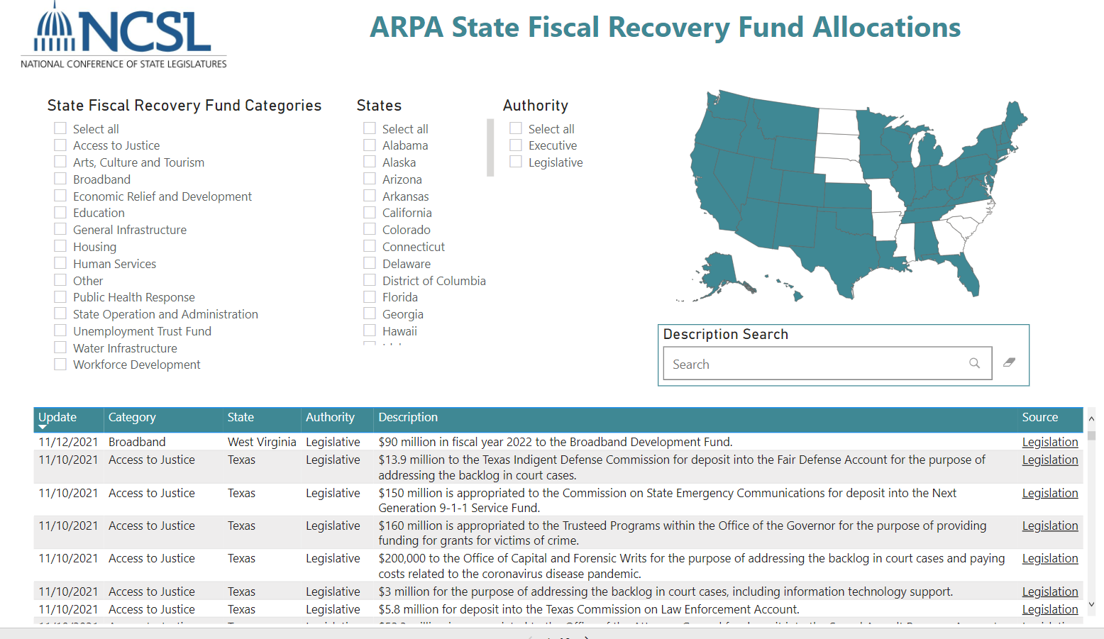






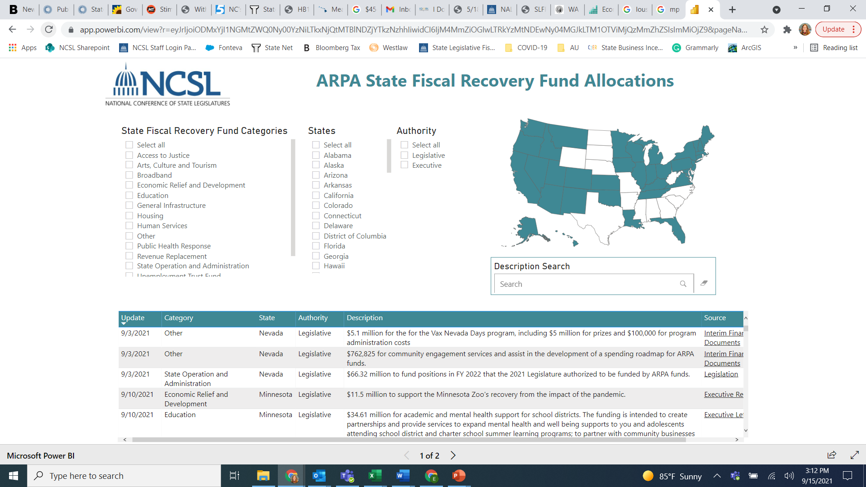



CSFRF Major
Allocation
Categories
Broadband
Economic Relief
Education
Housing
Human Services
State Ops/Admin.
Unemployment Trust Fund
Water Infrastructure
Workforce Development
Arts and Tourism
Public Health still a major priority!
12

Slide 13
*Number of states allocating to categories
*at least
18
17
20
18
19
Broadband
Economic Relief
Education
Housing
Human Services
25
16
16
17
23
State Ops/Admin.
Unemployment Trust Fund
Water Infrastructure
Workforce Development
Arts and Tourism
25
Public Health
13

Slide 14
Matching Grants to Local Governments
Broadband
Water
Other Infrastructure
MT - $275 million for communications projects related to broadband, cell towers and public safety.
TN Broadband Local Match Fund – Target localities using local fiscal recovery funds.
WI Broadband Expansion Grants – $100 million to targets households that lack access to a wireline connecting, prioritizes matching funds.
ME - $3 million for a competitive local matching grant program for upgrades of municipal culverts at stream crossings.
TN - $1 billion for a formula based matching sewer and water maintenance local grant program.
VA – 100% matching grants to three major cities for sewer overflow control projects.
MI - $75 million for capital infrastructure grants to districts for HVAC/equipment costs.
VA
  $22.5 million to support the removal or rehabilitation of derelict structures fund program, 100% matching local and/or private funds.
  $250 million for ventilation improvement projects, 100% matching local grants.

Slide 15
Allocation Timelines Vary
Legislative procedures, spending authority, guidance and disbursement amount play a role.
Prior to Interim Rule
End of Fiscal Year
Special Session
Next Legislative Session

Slide 16
Approaches to Priorities and Implementation
CO
GA
KS
VT
MA
UT
Established a broad legislative framework.
Determined specific uses by transfer of funds to existing and new cash funds.
Governor created 3 bipartisan committees to consider proposals and make recs.
Broadband; Water and Sewer; Economic Impact
Governor’s SPARK Taskforce
Working Groups → Advisory Committee → Executive Committee → State Finance Council authorizes funds.
Established a set of criteria for how to spend the funds.
Scored proposals based on criteria
Divided funds into buckets
3 phase recovery plan.
Phase I –Urgent Needs (now-Jan ‘22)
Phase II – Additional Recovery Projects (Jan ‘22)
Phase III –Multi-Year Recovery Projects

Slide 17
Avoiding the Fiscal Cliff
Managing one-time expenditures
  Distinguishing budgets and projects
    Non-recurring vs. recurring
  Coordinating with local governments
Long-term fiscal planning
  Multi-year budgeting practices
  Innovative, big picture goals achieved strategically (e.g., housing, broadband, etc.)
  Flexibility with investment strategies
  Adjusting for influx of state revenues and federal stimulus
  Planning beyond ARPA

Slide 18



Please feel free to reach out!
Emily Maher
emily.maher@ncsl.org
www.ncsl.org
Notes:
Finally, here

