Slide 1
Restaurant Labor
Current Analysis and
Future Implications

Slide 2
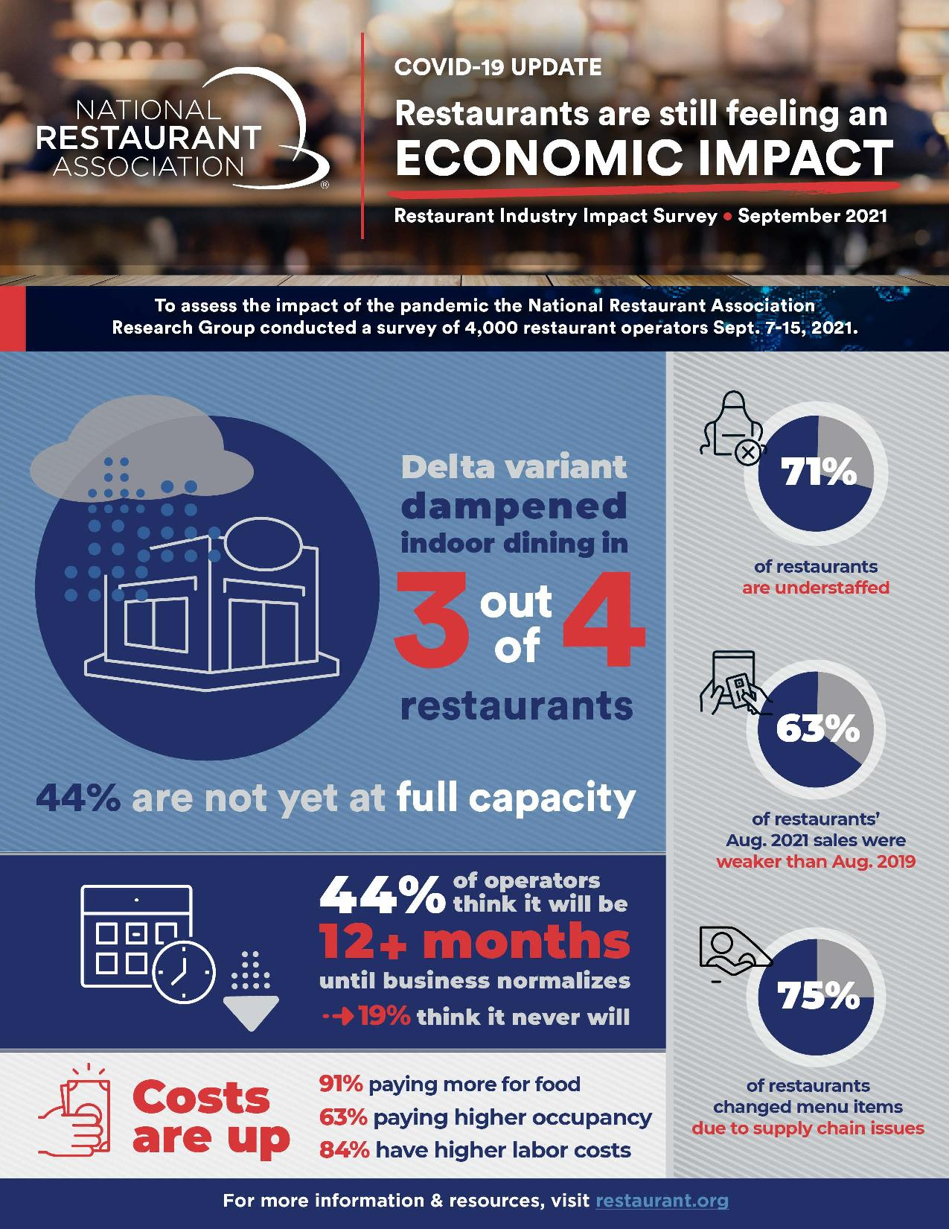

Slide 3
Labor Shortage
The shortage began prior to COVID. Employees sought higher paying jobs in other industries.
COVID exacerbated the shortage primarily from stimulus payments, Federal Unemployment benefits and other financial aid available.
71% of operators report still being understaffed according to the most recent NRA survey.
As a result of labor shortages, some operators are reducing their hours of operation, and in some cases, the days of the week they are open.

Slide 4
Increased Wages
To attract employees, many operators are now offering higher wages, signing bonuses, 90-day bonuses, and benefits packages including health insurance, retirement and paid vacation.
According to the U.S. Bureau of Labor Statistics, Average Hourly Earnings in the Leisure and Hospitality Industries increased by 12.77% in the past 12 months.
(August 2021- $16.60 compared to August 2020- $14.72)

Slide 5
Increased Wages
Many local operators now offer the following range of wages:
Front of House (Servers, Bartenders, Hostesses)
Servers/Bartenders- $2.13 (Tipped Employee Wage) +
Tips – Fine Dining Yields as much as $25/Hour
Hostesses $9 - $16/Hour
Back of House (Chefs, Line Cooks, Dishwashers)
$9 - $20/Hour

Slide 6
Future Implications
Federal Minimum Wage and Tipped Employee Wage Increase?
When and How Much?
A minimum wage increase affects all employees, even those making more money by virtue of their skills or seniority.
Food Costs Continue To Rise. The USDA predicts the following increases in 2021:
Beef- 14-17% Poultry- 19-22%
Pork- 18-21% Vegetables- 15-18%

Slide 7
Future Implications
Increases in Prime Costs (Food and Labor) Result in Increased Menu Prices as Operators Attempt to Protect Profit Margins.
Menu Prices Have Increased by 4.4% in the Past 12 Months (Compass Restaurant Consulting & Research, August 2021)

Slide 8
Industry Impact
Frequency of Dining Away From Home Decreases
Overall Decrease in Sales
Some Operators Will Not Survive

