Slide 1
Medical Benefits of Cannabis
FDA Approved Cannabis Products
  Marinol and Syndros (synthetic THC Max daily 20mg/16.8mg) and Cesamet (THC analog) - anorexia associated with weight loss in patients with Acquired Immune Deficiency Syndrome (AIDS), nausea and vomiting associated with cancer chemotherapy in patients who have failed to respond adequately to conventional antiemetic treatments.
  Epidiolex (CBD) - treatment of seizures associated with Lennox-Gastaut syndrome, Dravet syndrome and tuberous sclerosis in patients 1 years of age and older

Slide 2
Medical Uses of Non-medical Cannabis
Limited evidence that cannabis may alleviate neuropathic pain in some patients
Insufficient evidence exists to demonstrate analgesic effects in patients with other types of chronic pain
Use of Cannabis for chronic pain is under studied
Sativex (nasal spray 2.7mg THC/2.5 mg CBD) – modest short-term improvements in pain related to rheumatoid arthritis. Max 16.2 mg / day. Approved outside of US for spasticity associated with MS.

Slide 3
Known Potential Harms Cannabis (THC)
Cannabis dependence: 9-10% lifetime risk, 17% with initiation during adolescence
20 year prospective study: Persistent and dependent users lost 6 IQ points and Nonusers gained 1 IQ point
Conclusive or Substantial Evidence for a statistical association between cannabis smoking*:
  More frequent chronic bronchitis episodes (long-term cannabis smoking)
  Increased risk of motor vehicle crashes
  Lower birth weight of offspring (maternal cannabis smoking)
  the development of schizophrenia or other psychoses, with the highest risk among the most frequent users
*National Academy of Sciences

Slide 4
Health Concerns among Cannabis Users
Alcohol - alcohol use disorder were six times more likely
Tobacco (nicotine) use disorder about six times more likely
4.6 x more likely to abuse opioids
Higher risk of cocaine and methamphetamine use
2-3 x increased risk of depression
2-3 x increased prevalence of schizophrenia compared with nonusers. Stronger with earlier age of onset of use (eg, early adolescence), more intense cannabis use.

Slide 5
Hospitalizations Associated with Substance Abuse
 | Alcohol | Opioids | Cannabis | Cocaine | Stimulants
2016 | 17,004 | 5,196 | 9,982 | 4,369 | 3,991
2017 | 16,896 | 5,828 | 11,030 | 4,879 | 5,101
2018 | 16,825 | 5,251 | 10,659 | 4,807 | 5,673
2019 | 16,872 | 4,938 | 10,570 | 4,677 | 6,093
2020 (Q1-Q3) | 12,162 | 3,439 | 8,025 | 3,320 | 4,651

Slide 6
Neonatal Hospitalizations
Neonatal Hospitalizations Related to Maternal Drug Use by Types of Drugs, Mississippi, 2019
Type of Drug | Hospital Stays | Percent
Unknown/other drugs of addiction | 405 | 47%
Cannabis | 255 | 30%
Cocaine | 58 | 7%
Opiates | 54 | 6%
Amphetamines | 41 | 5%
Neonatal withdrawal syndrome | 139 | 16%
These groups are not mutually exclusive and their sum is higher than the total number of discharges.

Slide 7
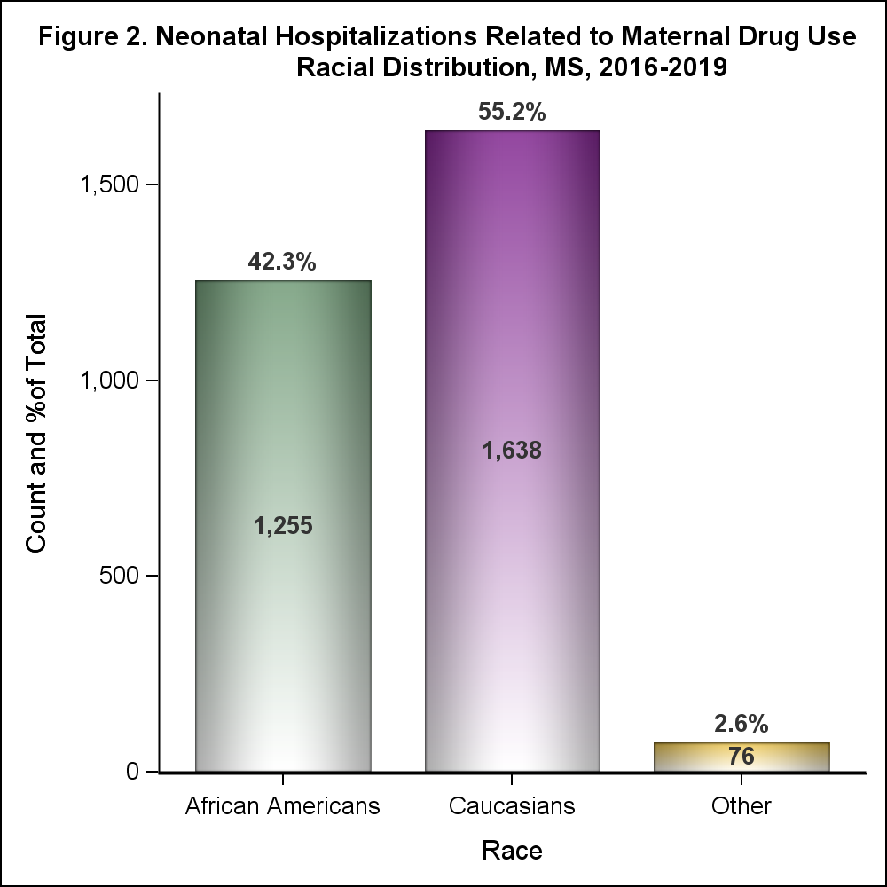
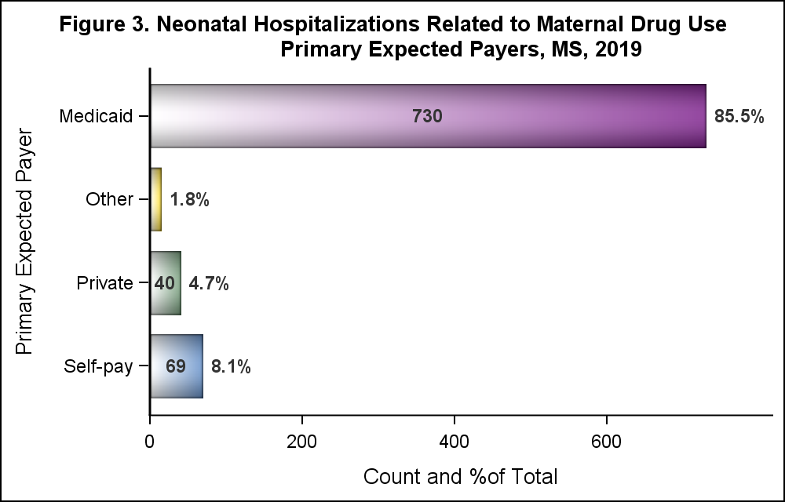
Demographics
55.2% Caucasians; 85.5% covered by Medicaid and 8.1% uninsured

Slide 8
MSDH Board Objectives of MS Medical Marijuana Program
Enable availability of MM for qualifying patients
Protect vulnerable populations (youth, pregnant women)
Community Impact Mitigation
Compliance (prevent fraud/unintended effects)
Communicate with public program development process
Prevent drug diversion
Prevent criminal involvement
Minimize equity issues
Prevent substance abuse / adverse consequences
Fiscal sustainability
Ensure Product Safety

Slide 9
What we learned along the way…
Enable availability of MM for qualifying patients
  Run program efficiently
  Active involvement of physician community and Medical Licensure
Protect vulnerable populations (youth, pregnant women)
  Limit THC to medicinal levels
  Non-smoking formats
  Ensure parental approval / extra safety
  Limit advertising and restrict to packaging not appealing to kids or for recreational use
Community Impact Mitigation
  Limit advertising
  Smart zoning
  Fund support services (ie mental health, law enforcement)
Compliance (prevent fraud/unintended effects)
  Seed-to-sale tracking essential
  Limit to indoor/greenhouse growing

Slide 10
Communicate with public program development process
  Regular broadcasted board meetings
  Community town-hall
Prevent drug diversion
  Seed-to-sale tracking
  Non-smoking formats
  Restrict certain felonies from business
  Indoor/greenhouse growing only
Prevent criminal involvement
  Seed-to-sale tracking
  Restrict certain felonies from business
  Indoor/greenhouse growing only
Minimize equity issues
  Very difficult – high barriers to entry
  Risks of low licensing fees
  Permit non-violent drug possession felonies to participate
  Ancillary service opportunities

Slide 11
Prevent substance abuse / adverse consequences
  Use medicinal THC doses
  Non-smoking formats
  Ensure physician accountability
  Support mental health services
  Advertising and packaging regulations
Fiscal sustainability
  Adequate fees to support operations
Ensure Product Safety
  Robust lab safety program
  Proper packaging and labelling

