Slide 1
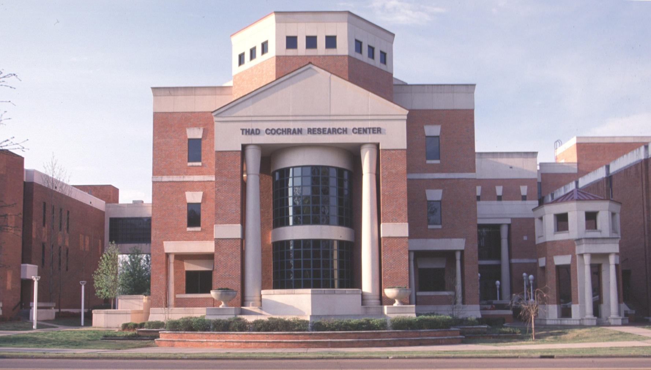
Medical Marijuana in Mississippi
Larry Walker, Director Emeritus, NCNPR
National Center for Natural Products Research
Research Institute of Pharmaceutical Sciences
School of Pharmacy, The University of Mississippi

Slide 2
Medical Marijuana in Mississippi
Cannabis and cannabinoids
Medicinal benefits of Cannabis
Evolution and range of state Medical Marijuana programs
Components of a sound medical approach
Legislative vs. administrative

Slide 3
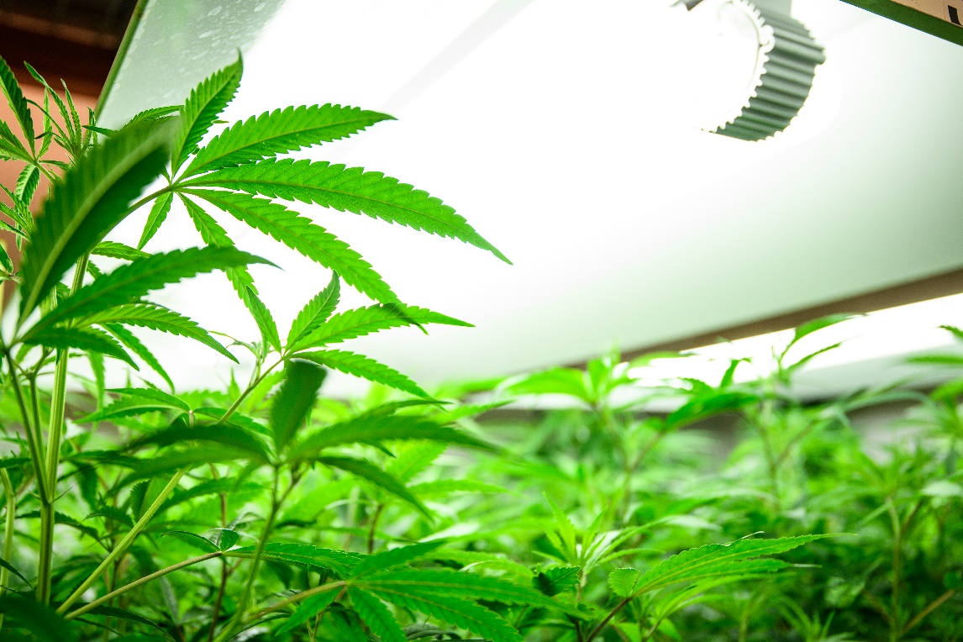
1. Cannabis and Cannabinoids
More than 500 compounds discovered in Cannabis
More than 120 “cannabinoids”: THC, CBD, CBG, CBC, etc.
THC and CBD are of primary interest now medically
THC (Δ9 or Δ8) are psychoactive
Pure THC

Slide 4
2. Potential Medical Benefits of Cannabinoids
(at present, primarily THC or CBD)
Nausea and vomiting
Appetite stimulation
Motor control, spasticity
Seizures
Pain perception and processing
Others?
With any medical treatment:
  Dose matters!
  Delivery route matters!
  Product quality matters!
  Monitoring of benefit
  Assessment of risks

Slide 5
I-65 and SB 2765: Simple Medical Questions
  What is it? 2.5 oz of what? – buds, extract, solutions, gummies?
  THC content???
  Route of administration (smoking, vaping, dabbing, oral, topical)?
  Product promotion
  Product quality and consistency
  Formulation
  Indications
  Dose level, frequency
  Risk/benefit assessments (clinical trials)
  Outcomes
  Adverse events

Slide 6
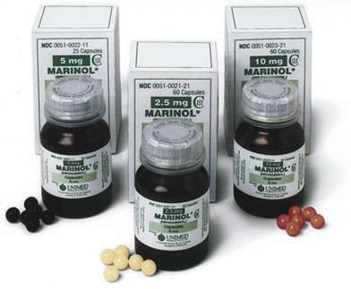
2.5 oz of MJ w 10% THC
would be equivalent to
700 of high dose Marinol
capsules
Top end dosage 4 per day of 10 mg

Slide 7
3. Evolution of State Medical Marijuana Programs
  First wave – ballot initiatives, 1996 – 1999
    7 states, including CA, OR, WA, AZ, AK, NV, ME
    Primarily smoking, legal protections, little attention to quality/source
    Most of these states are now recreational use states
  Early legislative initiatives, 2000 – 2008
    8 more states during this period; others “decriminalized” medical use
    Patient registries
    More explicit allowances on source/supplies
    Expanding variety of product types
    Revenue streams established in many states

Slide 8
Evolution of State Medical Marijuana Programs
  2nd generation legislation, 2009 – present
    Another 20+ states with comprehensive programs
    Regulation of growers, distribution, dispensaries
    More medical care integration
    Growing focus on testing/labeling
    Growing dependence on revenue streams
    Migration of many MM states to recreational (11)

Slide 9
4. Components of a sound medical approach
Designed and run by MDOH w other agencies
Roles for physicians, pharmacists, health professionals
Testing consistent quality products in defined indications
Patient registry
Documenting outcomes in an unbiased way
Helping patients in the process

Slide 10
5. Legislative issues?
Objectives medically and fiscally
Responsible agencies
Legal protections for patients, caregivers, health professionals
Revenue allocation by state
Consistency with other state laws

Slide 11
What about Mississippi?
Three Possible Paths
We could follow everyone else… irreversibly
We could hold out – another year or two?
Or we COULD lead the nation with a medically sound program…

